Slide 1

RELIANCE INDUSTRIES STOCK FORECAST
DATE:[22-03-2024]
P337 Group No.05
Mentor - Neha Ramchandani
Team- 1.Mr. SAPKESH TOMAR
2.Mrs. SHILPA M S
3.Ms. AKSHARA K K
4.Mr. P.SAI KUMAR
5.Mr.ANKIT VINOD DHAWADE
6.Mrs.VARSHA

Slide 2
BUSINESS OBJECTIVE:
Business Objective:
Predict the Reliance Industries Stock Price for the next 1 year.
The Open, High, Low and Close prices that you need to obtain from the web for day,
starting from April 2000 to March 2024 for Reliance Industries stock.
Split the last year into a test set- to build a model to predict stock price.
Find short term, &amp; long term trends.
Understand how it is impacted from external factors or any big external events.
Forecast for next 1 year.

Slide 3
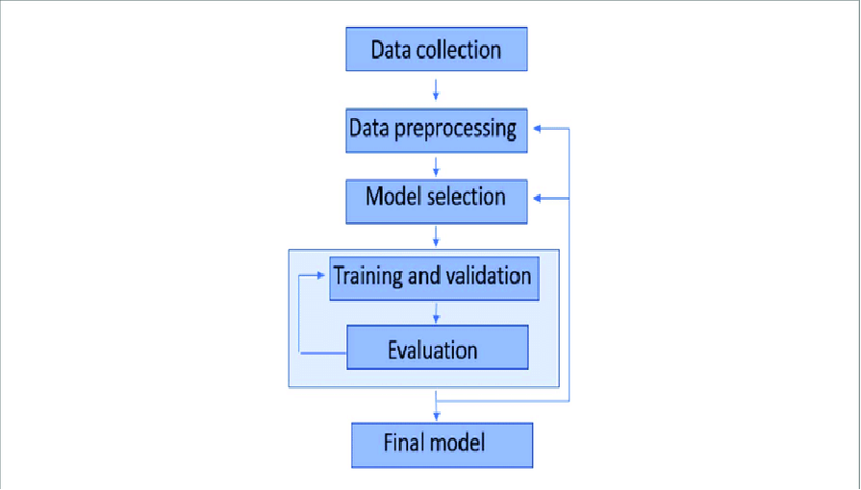
Project Architecture / Project Flow

Slide 4
DATA COLLECTION For this project, we will be using the Y finance library to get the data, which makes it easy to process.
We collected data from 2000-04-03 to 2024-03-22.
But also you can download data from ‘Yahoo! Finance’ website. You can use Below link. Reliance Industries Limited (RELIANCE.NS) Stock Historical Prices & Data - Yahoo Finance

Slide 5
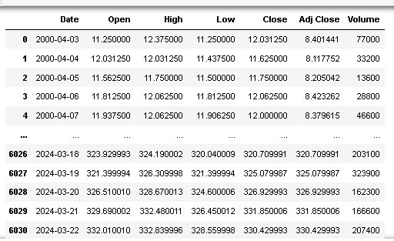

Slide 6
Date: Date of trad Open: Opening Price of Stock
High: Highest price of stock on that day
Low: Lowest price of stock on that day
Close: Close price adjusted for splits.
adj Close: Adjusted close price adjusted for splits and dividend and/or capital gain distributions.
Volume: Volume of stock on that day

Slide 7
DATA PREPROCESSING: >For this dataset there were no null values.
>There were zero duplicate records in the dataset
>‘Date’ column was not in datetime datatype, it was in object so we changed it into datetime.
>Renamed the columns names.
>Set ‘Date’ column as index column for visualization purpose.

Slide 8
Exploratory Data Analysis (EDA) and
Feature Engineering

Slide 9
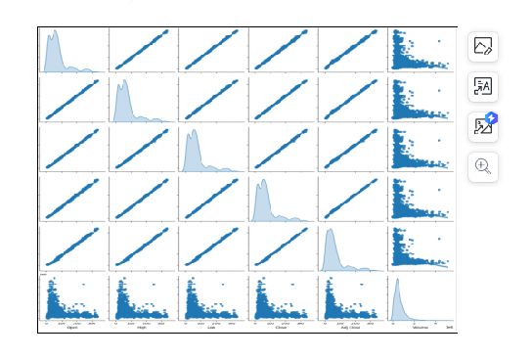
PAIRPLOT:
Positive Correlation: The scatter plots indicate a positive correlation between variables such as Open, High, Low, and Close prices. This suggests that when one of these prices increases, the others tend to increase as well.
Distribution Patterns: The histograms reveal different distribution patterns. For instance, the Volume histogram might show a right-skewed distribution, indicating that high-volume days are less frequent.
Volatility Insights: By examining the spread of data points in scatter plots, one can infer the volatility of stock prices. A wider spread could indicate higher volatility.
Price Movements: Assuming a 15% hike in the Close price, we can expect a similar hike in the Open, High, and Low prices due to their strong correlation.

Slide 10
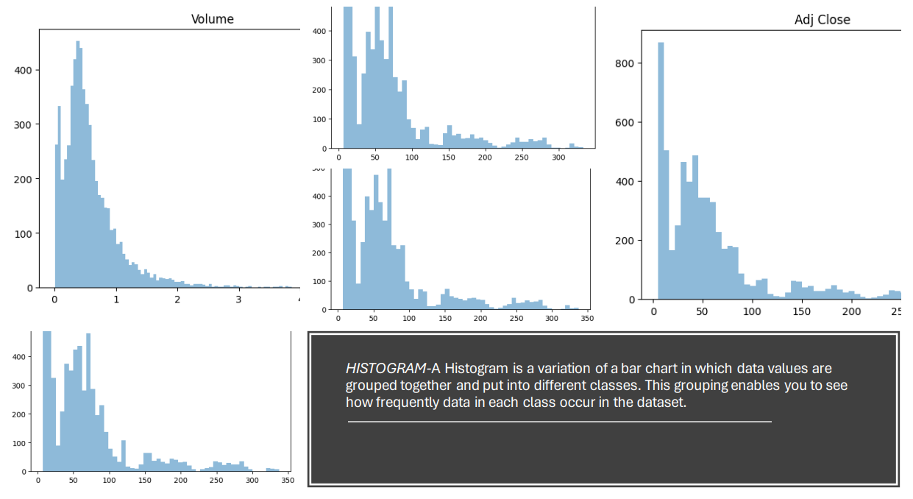
HISTOGRAM:
Volume Distribution:
High frequency of data points near zero volume.
Exponential decrease in frequency as volume increases.
Indicates most trading days had low trading volume.
Unlabeled Variable Distribution:
Presence of multiple peaks suggests a multimodal distribution.
Could indicate the presence of different groups or behaviors in the dataset.
Adjusted Close (Adj Close) Distribution:
Most data points are concentrated in the 0-50 range.
Sharp decline in frequency for higher values.
Suggests that the stock price was most commonly valued between 0 and 50 units.

Slide 11
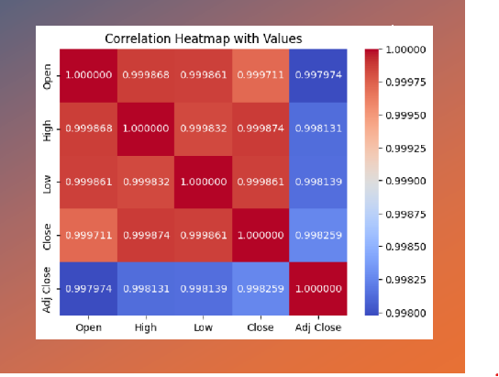
CORRELATION HEATMAP WITH VALUES:
Strong Positive Relationships:
1.There are strong positive correlations between the stock market attributes such as Open, High, Low, Close, and Adjusted Close prices.
2.This suggests that these variables tend to move in the same direction; as one increases, the others also tend to increase.
Heatmap Values:
1.The values in the heatmap likely range from -1 to 1, where values closer to 1 indicate a strong positive correlation.
2.High correlation coefficients (close to 1) between these attributes are expected because they are all related to the stock’s daily performance.
Implications for Analysis:
1.Such strong correlations might imply that any of these variables could be used as a proxy for the others in further analyses.
2.However, multicollinearity should be considered if you’re planning to use these variables in predictive modeling, as it can affect the model’s performance.

Slide 12
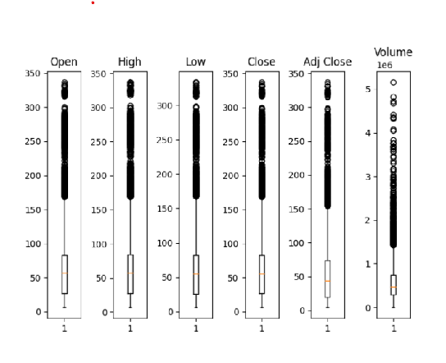
BOXPLOT:
Uniformity: The identical nature of the candlesticks suggests that this may be a stylized representation rather than actual data.
Lack of Variability: If this were actual stock data, the lack of variability would be highly unusual, as it would indicate no change in price over multiple periods, which is rare in a dynamic market.

Slide 13
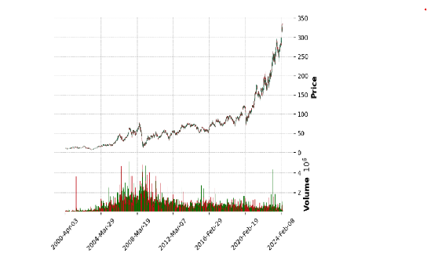
MPL FINANCE :
Steady Growth: The stock price of Reliance has shown a steady increase over the years, indicating consistent growth.
Recent Rapid Rise: There appears to be a rapid rise in the stock price in the more recent years, which could be due to various factors such as company growth, market conditions, or investor sentiment.
Trading Volume: The trading volume seems to fluctuate, with some periods of high volume. High trading volumes can often correlate with significant price movements, either up or down.

Slide 14
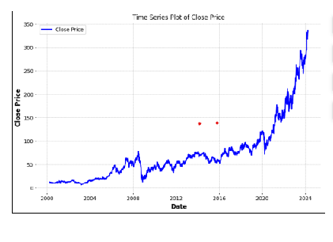
TIME SERIES PLOT OF CLOSE PRICE:
Growth Phase: The sharp rise after 2016 could indicate a phase of robust growth for Reliance, possibly due to successful business ventures, expansion, or positive market conditions.
Investor Confidence: The consistent upward trend may also reflect increasing investor confidence in the company’s future prospects.
Market Events: Specific peaks and troughs in the graph could correspond to market events, announcements, or changes in the economic environment that had an impact on Reliance’s stock value.
Volume of Trade: Although not depicted in the plot, a parallel analysis of the trading volume could provide insights into the liquidity and investor interest in Reliance stocks during this period.
Comparative Performance: Comparing this trend with market indices and competitors’ stock performance could offer a perspective on Reliance’s relative performance in the industry.

Slide 15
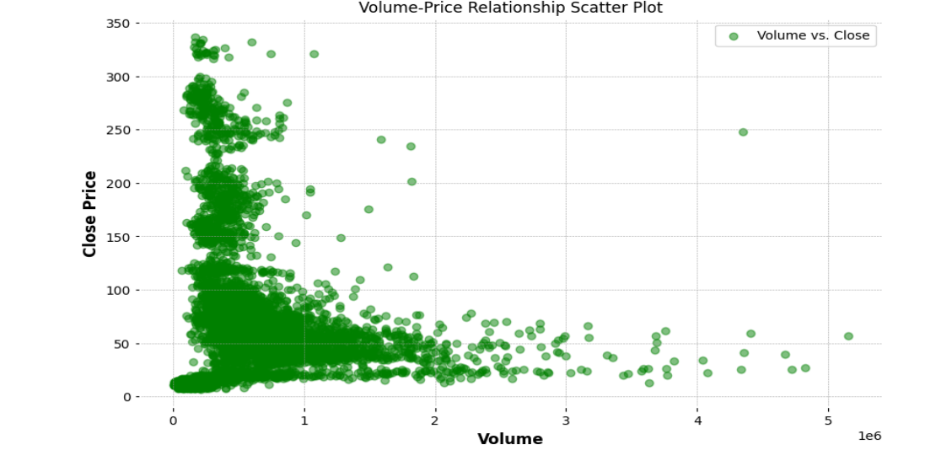
VOLUME PRICE RELATIONSHIP SCATTERPLOT:
Lower Volume Concentration: There is a concentration of data points at the lower end of the volume spectrum. This suggests that Reliance stocks were frequently traded at lower volumes.
Price Range Distribution: At these lower volumes, the closing prices also tend to be lower, indicating a period or periods where the stock price was relatively stable and not highly traded.
Volume-Price Spread: As the volume increases, there is a wider spread in the closing prices. This could mean that on days with higher trading volumes, the stock price experienced greater fluctuations.
Frequency of High Volume Trades: The scatter plot shows fewer occurrences of high volume trades, which could be associated with specific market events or news impacting the stock.
Potential Outliers: If there are data points that significantly deviate from the overall pattern, these could be outliers or anomalies that might warrant further investigation.

Slide 16
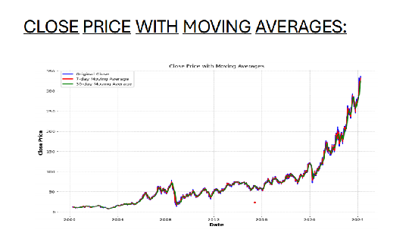
CLOSE PRICE WITH MOVING AVERAGES:
Upward Trend: The overall trend in the close price of Reliance stock is upward, especially after 2020, indicating a period of growth.
Moving Averages: The moving averages provide a smoothed view of the trend and can help identify the direction of the stock price movement. If the close price is consistently above the moving averages, it suggests a bullish market sentiment.
Price Stability: The periods where the close price and moving averages are close together may indicate stability in the stock prices.
Potential Buy/Sell Signals: Crossovers of the close price with the moving averages might be used as potential buy or sell signals by traders. For instance, when the close price crosses above a moving average, it could be seen as a buy signal.
Volatility: Any gaps between the close price and moving averages could indicate volatility. A widening gap may suggest increasing volatility, while a narrowing gap could indicate decreasing volatility.
Long-term vs Short-term Averages: Comparing short-term moving averages (like a 50-day average) with long-term ones (like a 200-day average) can give insights into short-term versus long-term trends and momentum.

Slide 17
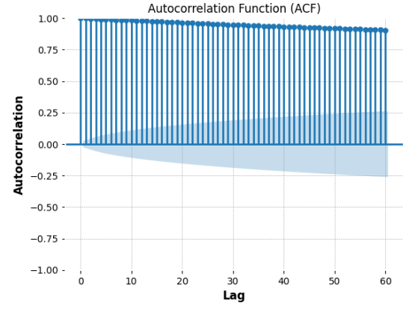
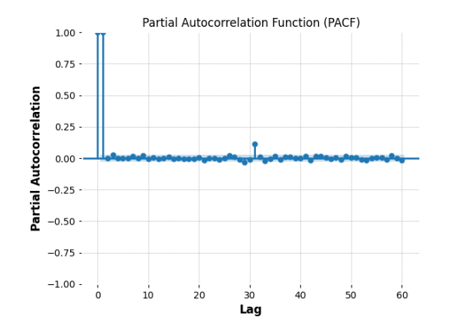
ACF AND PACF:
ACF Graph Inferences:
The ACF shows a gradual decline as the lags increase, which suggests a long-term positive correlation that diminishes over time.
The significant spikes at specific lags could indicate a seasonal pattern or cyclical behavior in the stock prices.
PACF Graph Inferences:
The PACF graph cuts off after a few lags, which typically suggests an AR(p) model could be suitable for modeling the data.
The sharp drop after the initial few lags indicates that the immediate past values have a strong influence on the current value, but this influence fades with more distant past values.

Slide 18
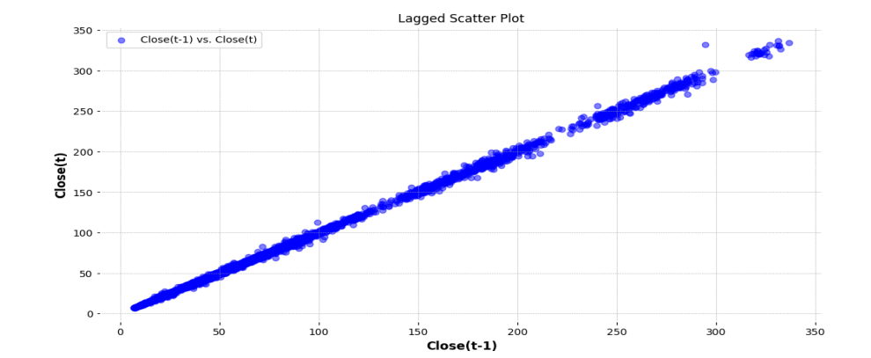
LAGGED SCATTER PLOT:
This pattern indicates that the stock price has momentum, meaning that if the price is moving in a certain direction, it tends to continue moving in that direction for some time.
The density of points near the origin could imply that smaller price changes are more common than larger price changes.
Since the points do not deviate significantly from the line of best fit, this implies low volatility in the stock price movements at these specific lags.

Slide 19
MODEL BUILDING

Slide 20

MODEL SELECTION: >Models Utilized:
Random Forest
K-Nearest Neighbors (KNN)
Support Vector Machine (SVM)
Gated Recurrent Unit (GRU)
Iterative Strategic Topic Modeling (ISTM)
>Optimal Selection:
Among the array of models employed, including Random Forest, KNN, SVM, GRU, and ISTM, it was evident that Iterative Strategic Topic Modeling (ISTM) stood out as the most fitting choice for our project's requirements and objectives.

Slide 21
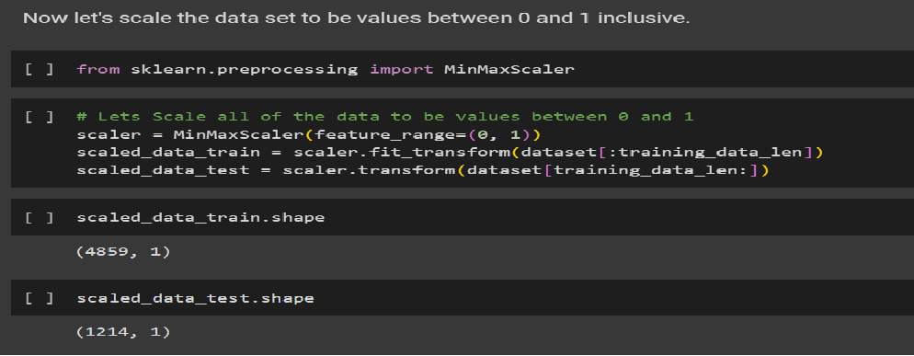
TRAINING AND VALIDATION LSTM Model
Here we are taking about 80% of the data as the training data.

Slide 22
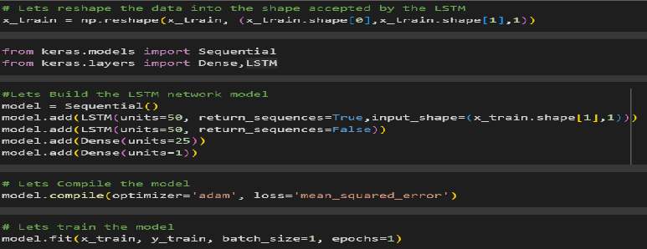
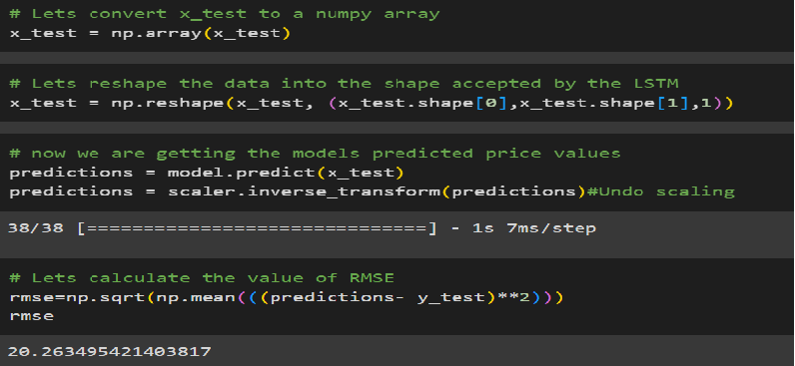

Slide 23
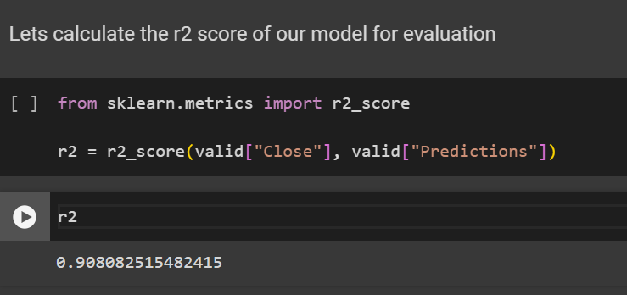
Let calculate the r2 score of our model for evaluation

Slide 24
Based on accuracy we choose LSTM model as final model
LSTMs are predominantly used to learn, process, and classify sequential data because these networks can learn long-term dependencies between time steps of data.
Common LSTM applications include sentiment analysis, language modeling, speech recognition, and video analysis.
Long Short-Term Memory (LSTM) is a type of Recurrent Neural Network (RNN) that is specifically designed to handle sequential data, such as time series, speech, and text.
LSTM networks are capable of learning long-term dependencies in sequential data, which makes them well suited for tasks such as language translation, speech recognition, and time series forecasting.
FINAL MODEL

Slide 25
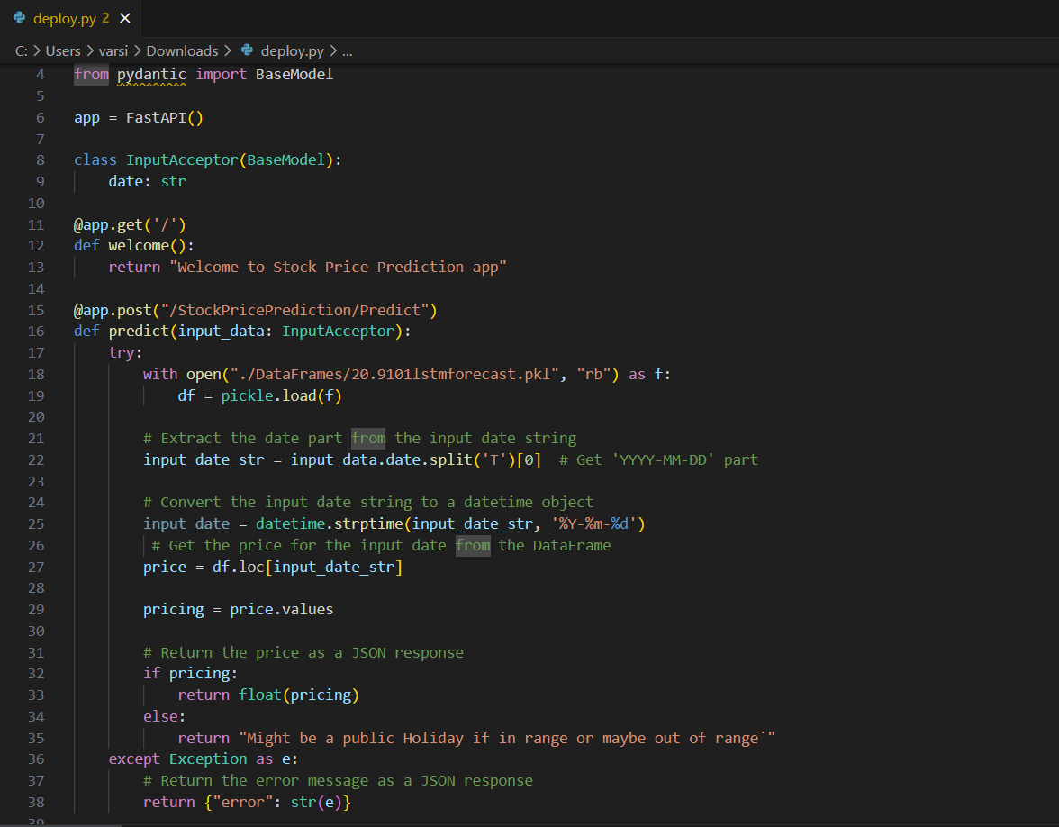
DEPLOYMENT
>Incorporates a pre-trained model to forecast stock prices. >Demonstrates the application's capability to utilize AI for real-world solutions.
> Implements try-except blocks to manage exceptions gracefully.
>Ensures user-friendly error messages for better user experience.
>Delivers predictions and messages in JSON format. Aligns with best practices for modern API design.
>Well-commented sections explaining functionality.
>Enhances maintainability and future updates. Ready for deployment with scalability in mind.
>Compatible with various cloud platforms and containerization technologies.
>An innovative solution leveraging Fast API and machine learning.
>A testament to the power of modern web frameworks in Python.

Slide 26
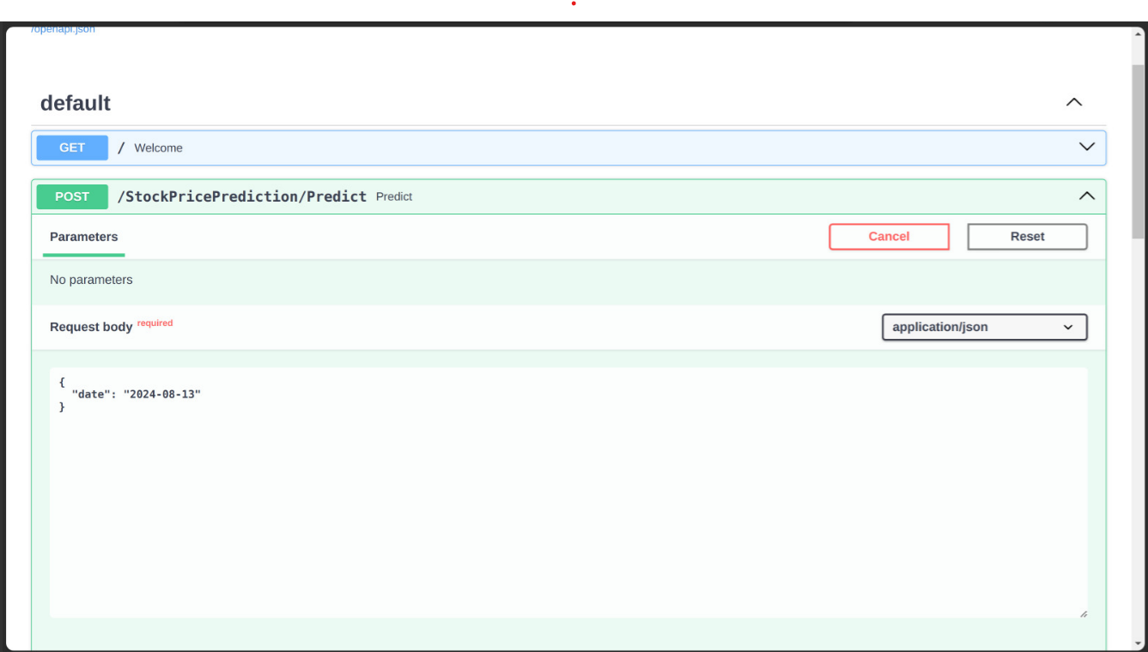
1.Welcome Message: Upon launching the application, users are greeted with a friendly welcome message. It’s like being welcomed by a host at the entrance of a financial event.
2.Entering the Date: Users are prompted to enter a specific date for which they want the stock price prediction. This is akin to selecting a day on a calendar to check an appointment.

Slide 27
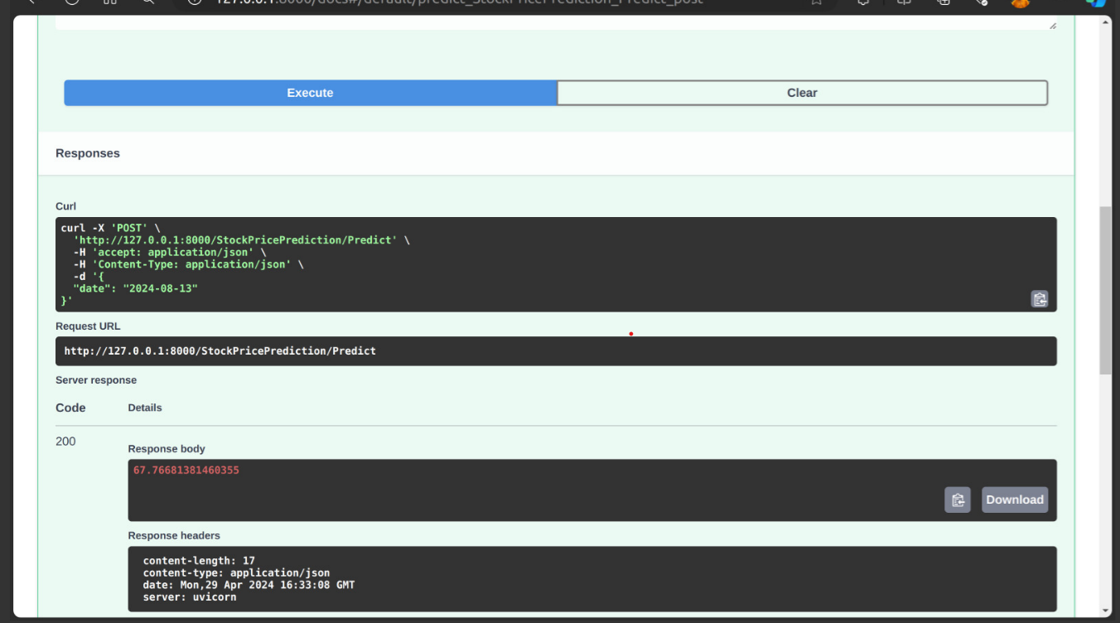
1.Clear Visualization: The predicted stock price is displayed prominently, making it easy for users to quickly identify the key information they need. It’s akin to a well-designed dashboard that highlights the most important metrics.
2,Receiving Predictions: After submitting the date, the application processes the request and provides the predicted stock price. It’s like asking a financial advisor for a forecast and getting an instant response.

Slide 28
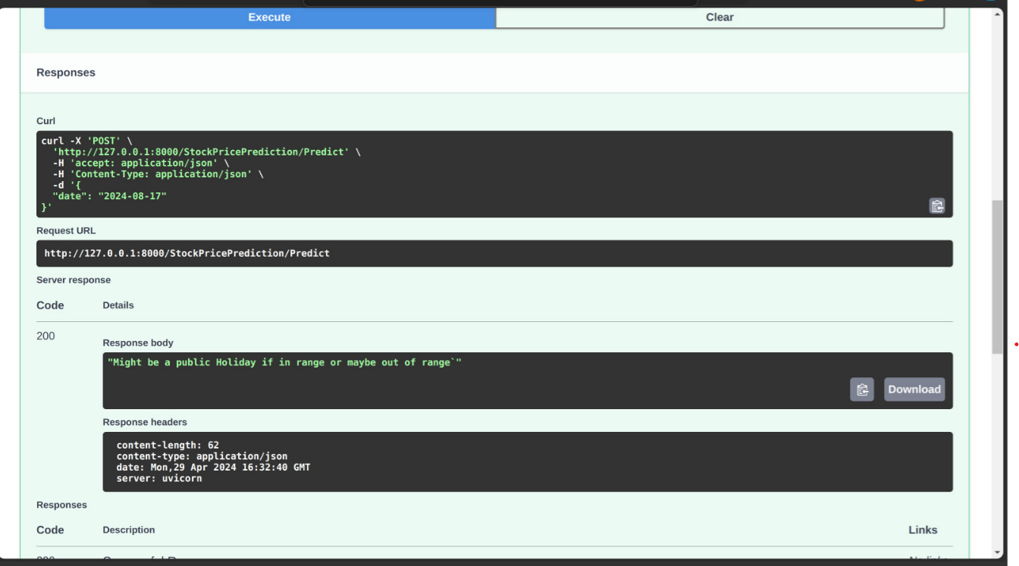
1.Error Handling: If a user enters a date that’s out of range or on a public holiday when the stock market is closed, the application will inform them of the error. This is similar to an online booking system letting you know if you’ve selected a date when the service is not available.
2.User Interface: The application’s interface is straightforward, focusing on functionality without unnecessary distractions. It’s designed to be intuitive, much like using a simple yet powerful financial calculator

Slide 29

THANK YOU

